Slide 1
Internship Presentation
Artificial Intelligence-Based Prediction of Tunnel Boring Machine Penetration Rate
By: Romain Siame
Supervisor: Yewuhalashet Fissha, PhD
National Institute of Technology, Asahikawa College

Slide 2
Artificial Intelligence-Based Prediction of Tunnel Boring Machine Penetration Rate
Internship Presentation
Romain Siame

Slide 3
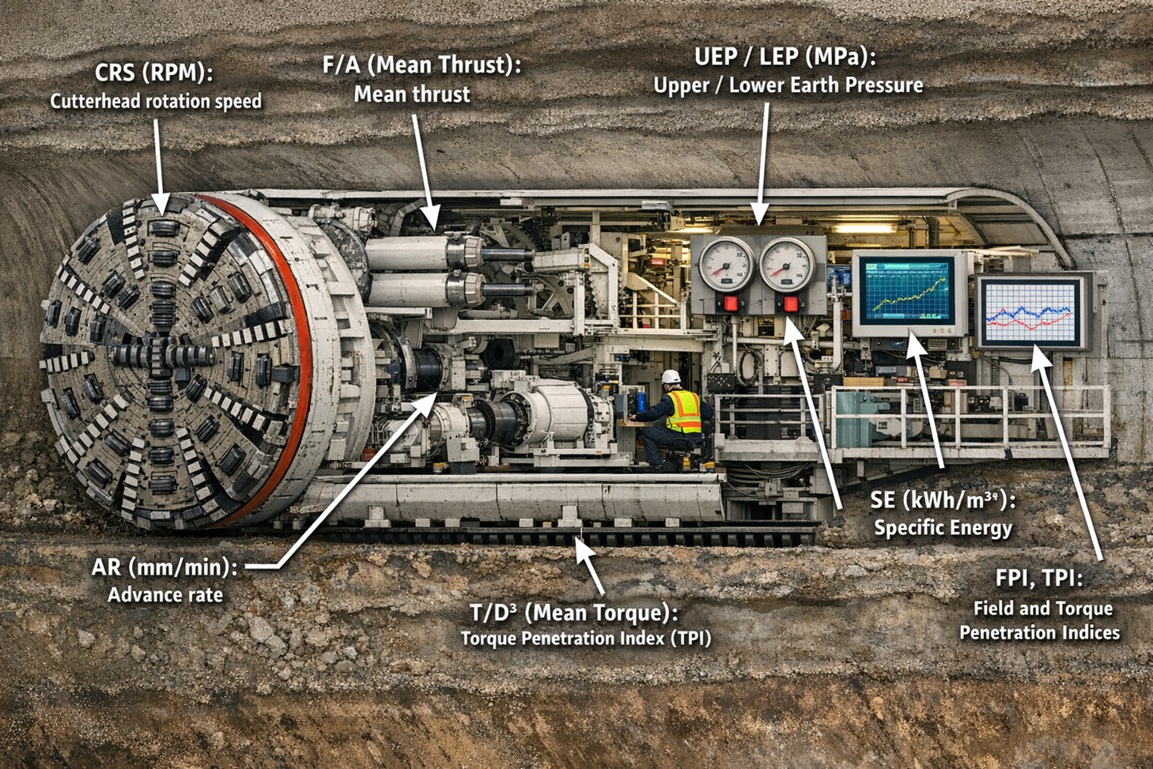
Tunnel boring machine (TBM)
Disc cutter
Rock

Slide 4
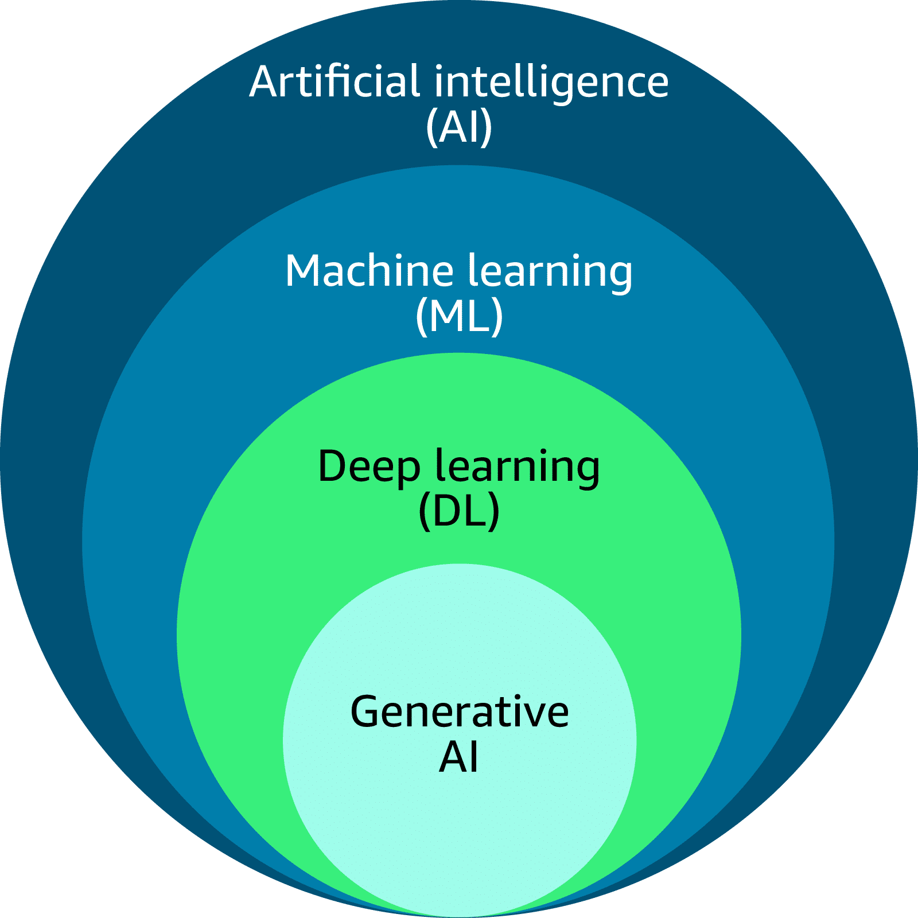
Artificial Intelligence

Slide 5
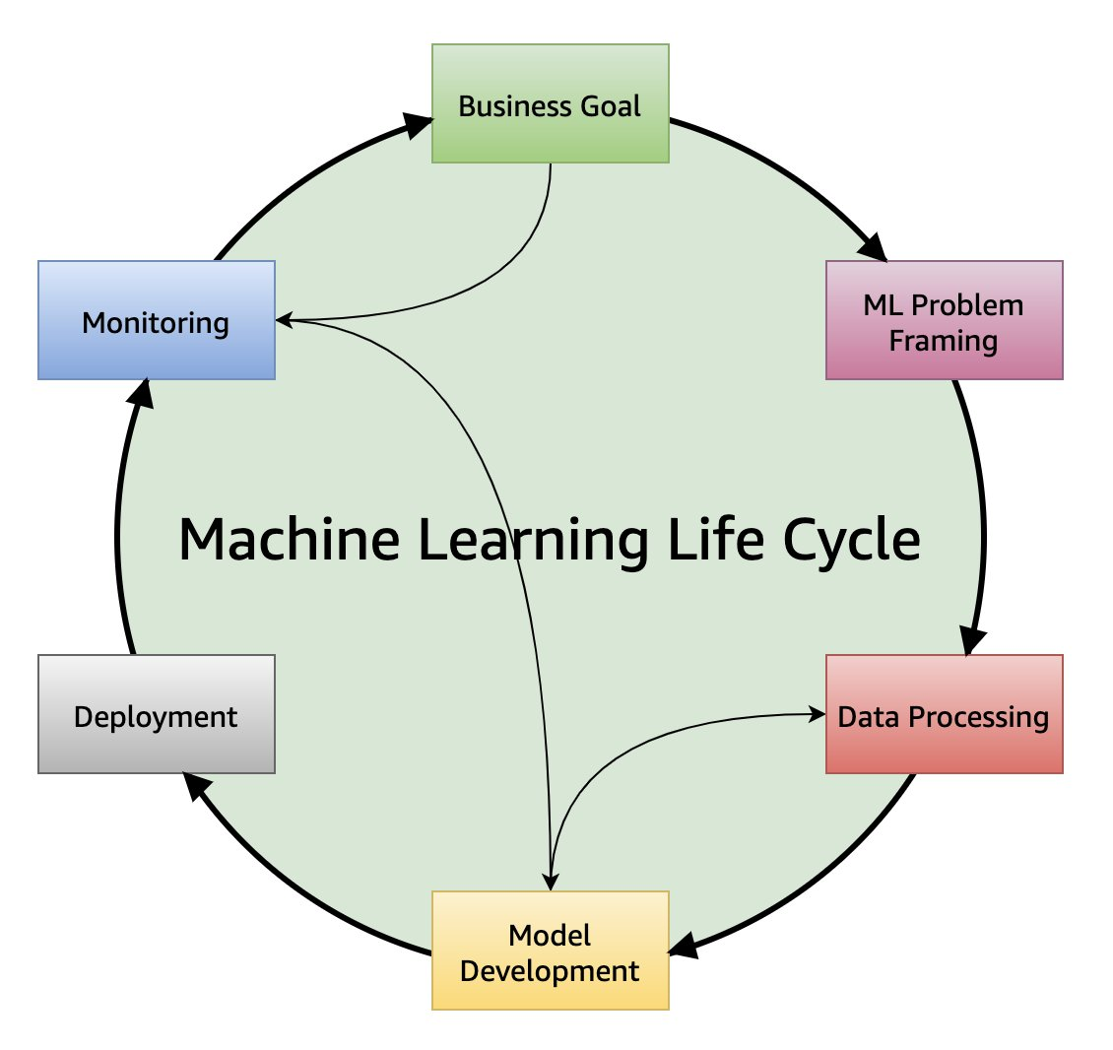

Slide 6
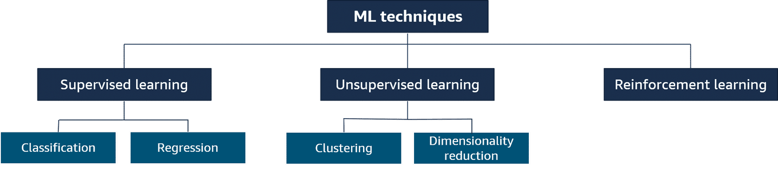
Target of this research

Slide 7
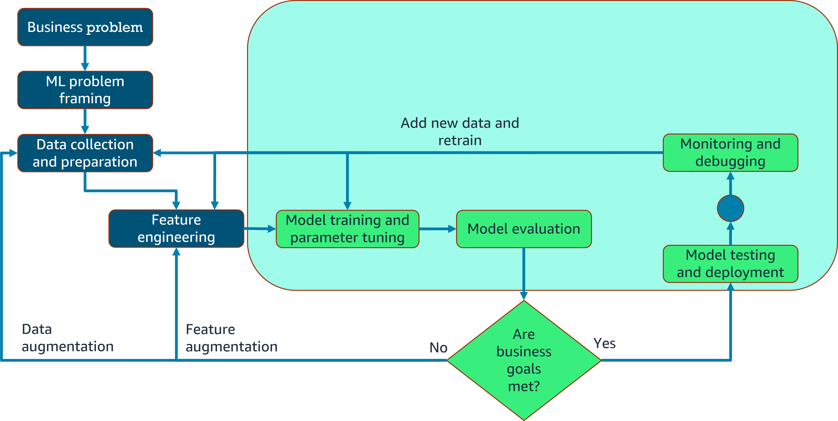
MLOps combines people, technology, and processes to deliver collaborative ML solutions.

Slide 8
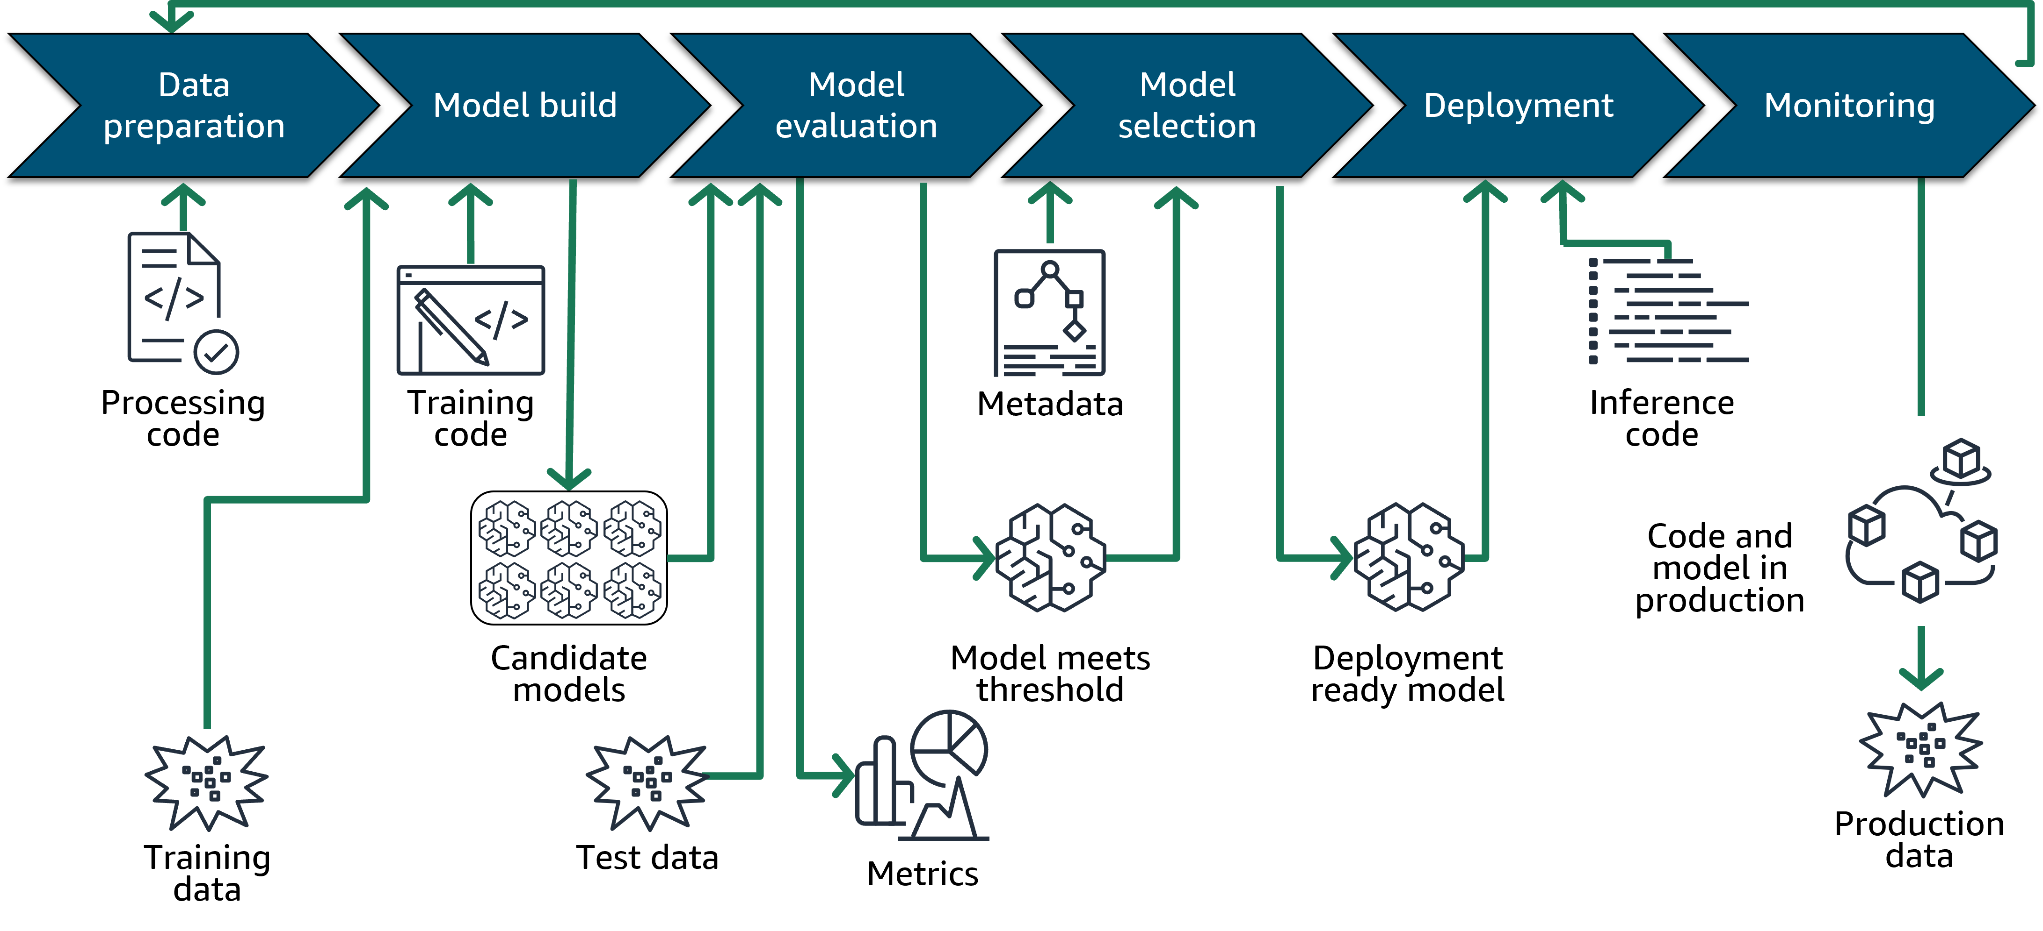
ML lifecycle and MLOps

Slide 9
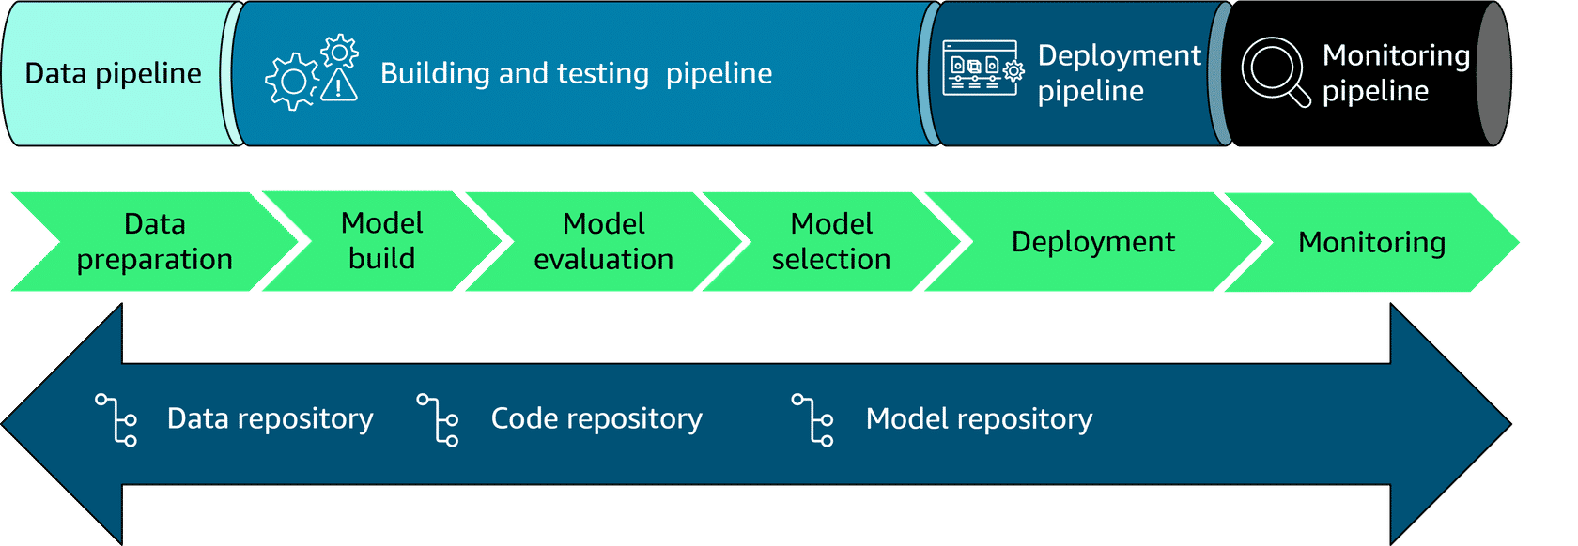
The following diagram is an example of an end-to-end automation process. A productionized ML lifecycle typically contains separate training and deployment pipelines.
To learn more, choose each of the numbered markers.

Slide 10
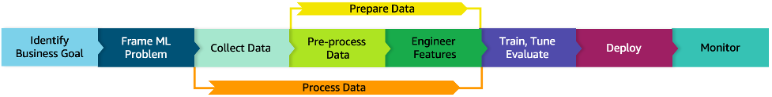

Slide 11
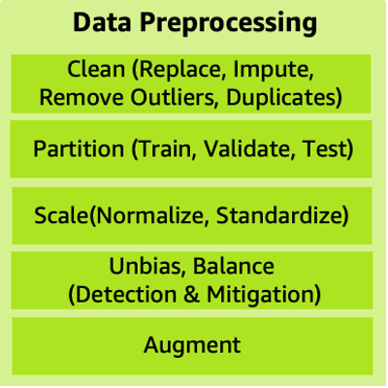
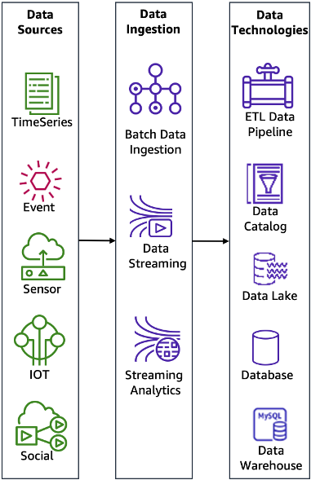
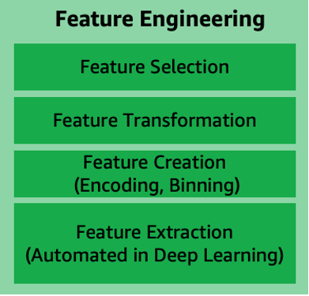

Slide 12
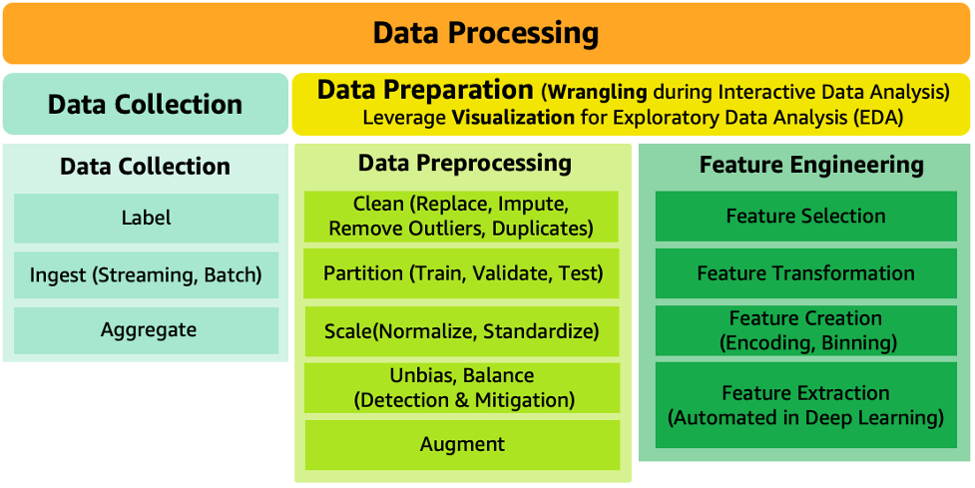
Data processing

Slide 13
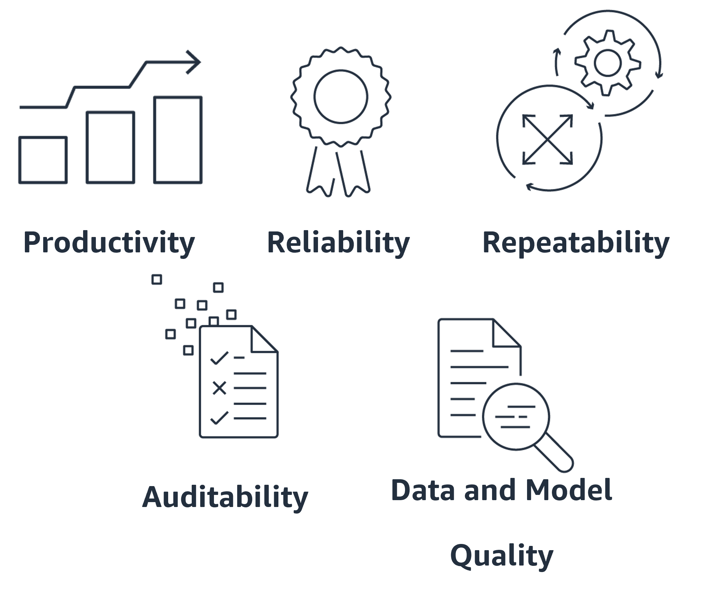
Benefits of MLOps

Slide 14
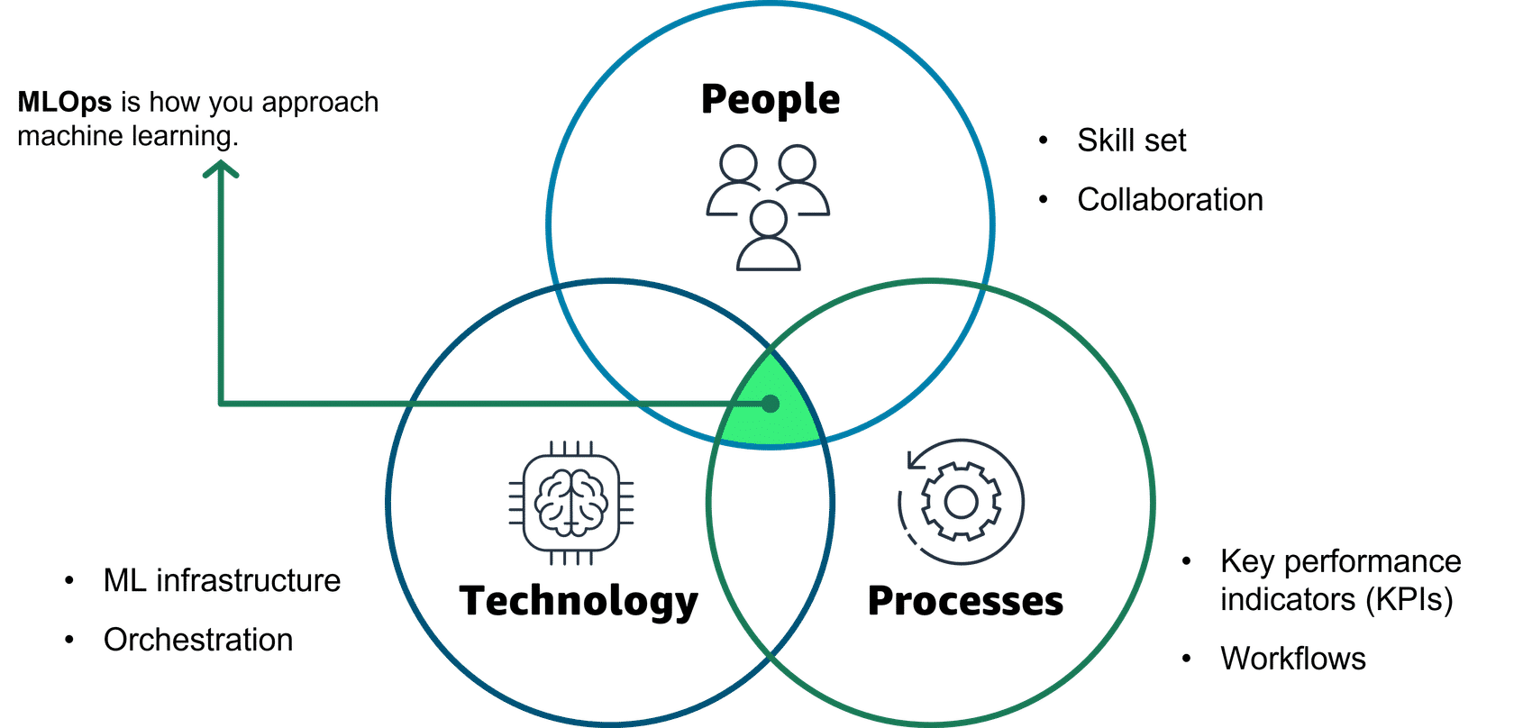
MLOps relies on a collaborative and streamlined approach to the machine learning development lifecycle. It is the intersection of people, process, and technology that optimizes the end-to-end activities required to develop, build, and operate machine learning workloads.

Slide 15
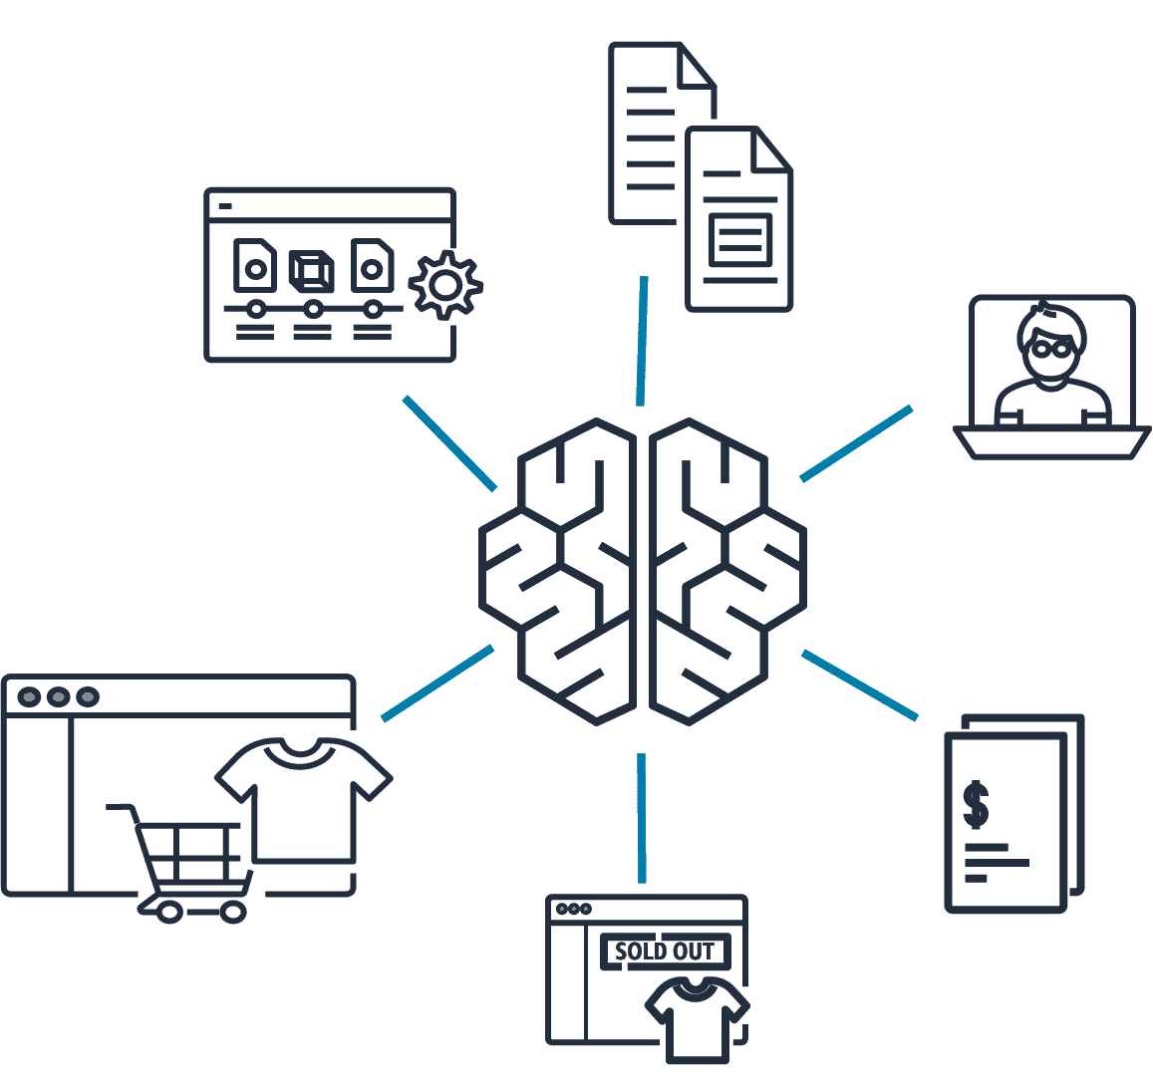
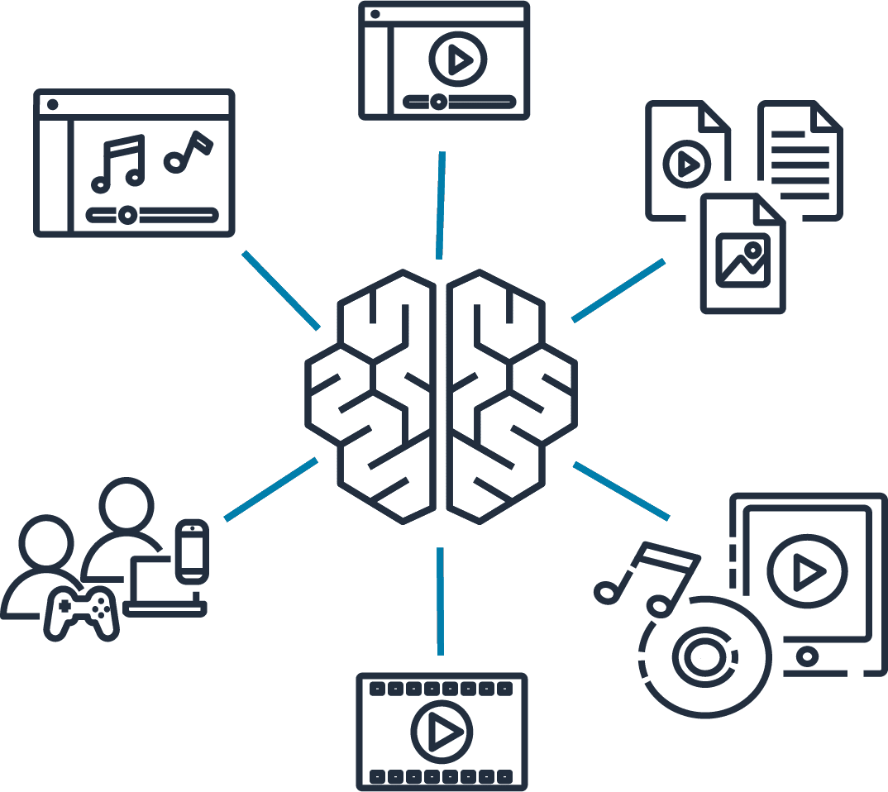

Slide 16
